Slide 1
Identifying ID Submissions using Computer Vision
Improving the customer experience in applying for a new digital bank account

Slide 2
Executive Summary
ASD

Slide 3

Indonesia has Huge Untapped Banking Market, but ID Verification is Laborious & Time-Consuming
Scenario: A digital bank in Singapore wants to expand its banking business into the Indonesian market
Opportunity:
Large under-served market: 4th most populous nation, 3rd largest unbanked population¹
Young, tech-savvy & tech-hungry population: median age is 30 years; has the 2nd highest interest level in digital financial services (Southeast Asia)²
Challenges:
No national digital ID: for account opening, laborious & time-consuming ID verification must be done with digital submission of physical documents (i.e. photos)
50%
(~140m) of population yet to have a bank account
146m
people are between 15 – 49 years of age³
Problem Statement: manual verification of ID submissions results in poor customer experience
[1] World Economic Forum, Feb 2022, [2] EY, Dec 2022, [3] United Nations Statistics Division Yearbook, 2020

Slide 4

Problem Statement
Indonesia presents a tremendous opportunity for digital banks
Indonesia is Southeast Asia’s largest economy – a growing powerhouse with a nominal GDP of US$1.05 trillion
The country is also the world’s fourth-most populous nation, where the median age is 29.7 years.
According to the World Economic Forum, Indonesia has the world’s third-largest unbanked population. only half the population has a bank account.
Indonesian respondents are highly interested in super apps that can deliver seamless integration of all their financial services. Indonesia has the second highest percentage (70%) of respondents in ASEAN countries that are very or extremely interested in super apps, which is much higher than Singapore (54%) and Hongkong (50%).
Large segment of population that is young, tech-savvy, underserved
Source: World Economic Forum, Feb 2022; EY, Dec 2022
Why digital KYC is good MAS

Slide 5
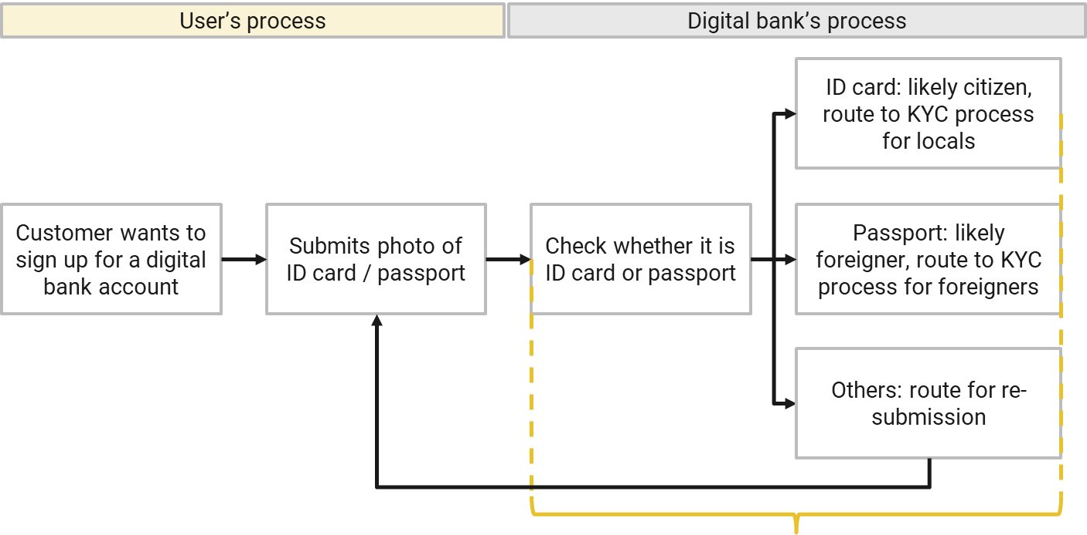


Currently, ID Verification takes: 3 – 5 Working Days
For the customer: tedious experience to wait 3 – 5 days to know whether submission is successful or not
For the bank: labour intensive, time-consuming
Processing time: 3 – 5 working days⁴
[4] as reference: an incorrect photo submission to Singapore’s ICA may double the process time (The Straits Times, May 22): 2 weeks for NRIC, 4 weeks for passport (ICA, n.d.)

Slide 6
Goal: To Reduce to <30 Seconds for Each Submission
To enable process automation & process acceleration, the bank tasked me to develop a model to predict ID document submissions
Processing time: <30 seconds

Slide 7
Goal: To Reduce to <30 Seconds
To enable process automation & process acceleration, the bank tasked me to develop a model to predict ID document submissions
Processing time: <30 seconds

Slide 8
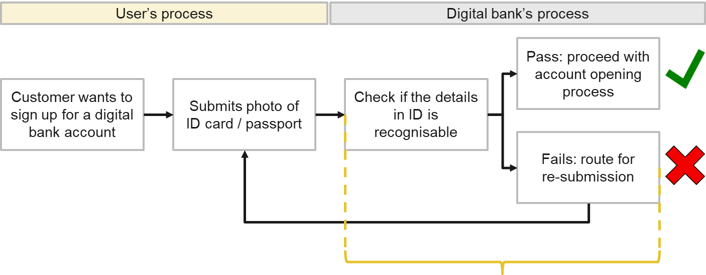
Problem Statement
A digital bank in Singapore wants to shorten its account opening process by automating its customer identification (ID) validation process. Currently:
Processing time: 3 – 5 working days*
*For reference: an incorrect photo submission to Singapore’s ICA may double the process time (The Straits Times, May 22): 2 weeks for NRIC, 4 weeks for passport (ICA, n.d.)

Slide 9
Goal
Using computer vision, automatically and quickly evaluate the submitted photo with the digital bank’s photo guidelines:
Processing time: <1 min
Challenge: multi-class object detection in images

Slide 10
Dataset – 1,000 Photos
 | Train 600 photos | Validation 200 photos | Test 200 photos
ID cards | 300 from Slovakia, Spain, Finland (100 each) | 100 from Estonia | 100 from Albania
Passports | 300 from Latvia, Russia, Greece (100 each) | 100 from Serbia | 100 from Azerbaijan
Mock ID documents: European and North-West Asian, each with unique text fields and artificially generated faces
Separated nationalities: Train, validation & test datasets each have unique nationalities to prevent data leakages
More details in Annex

Slide 11
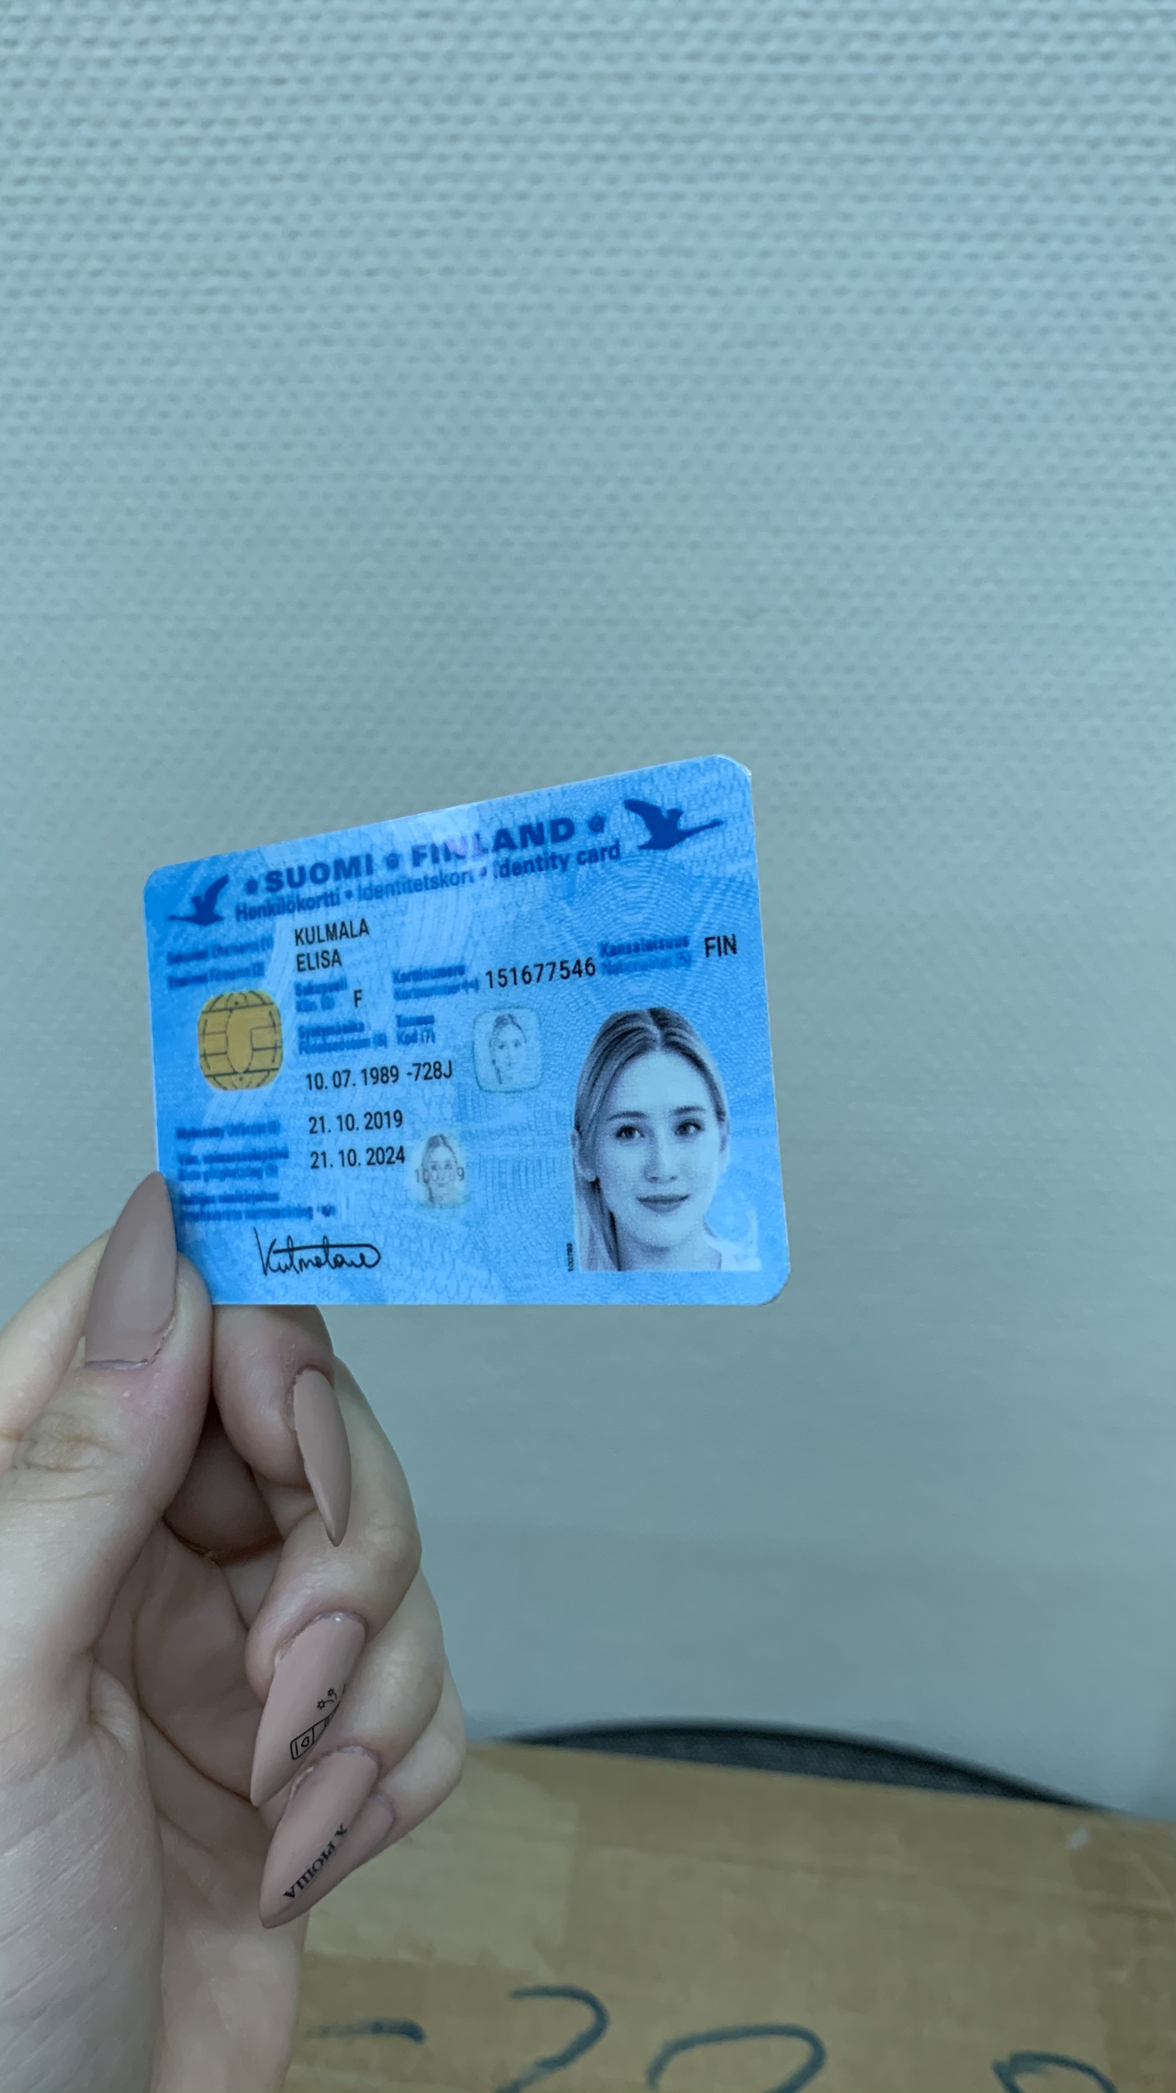
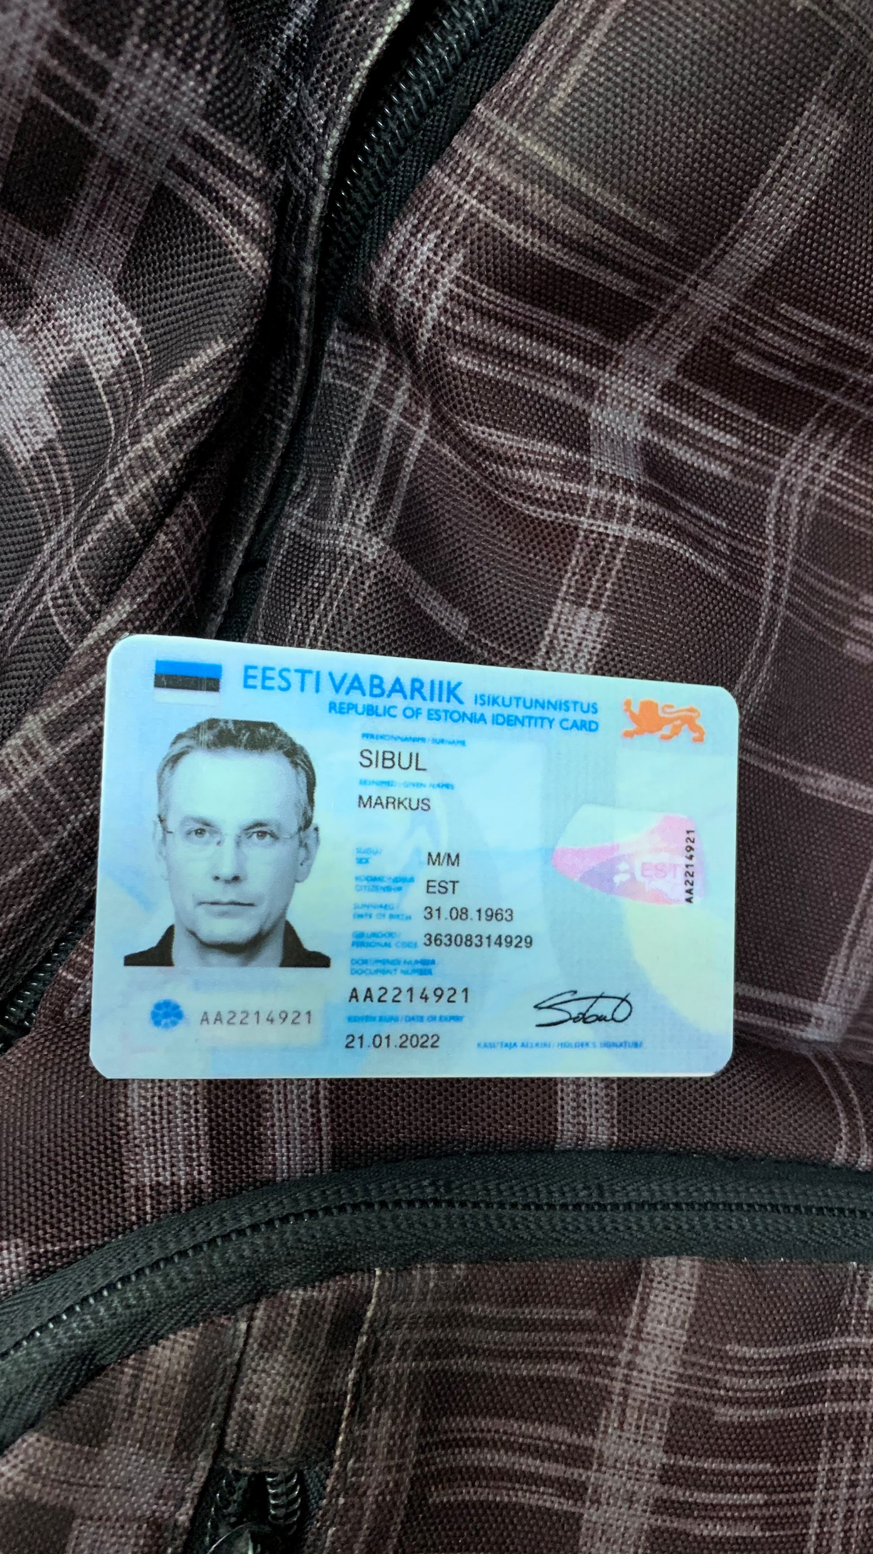
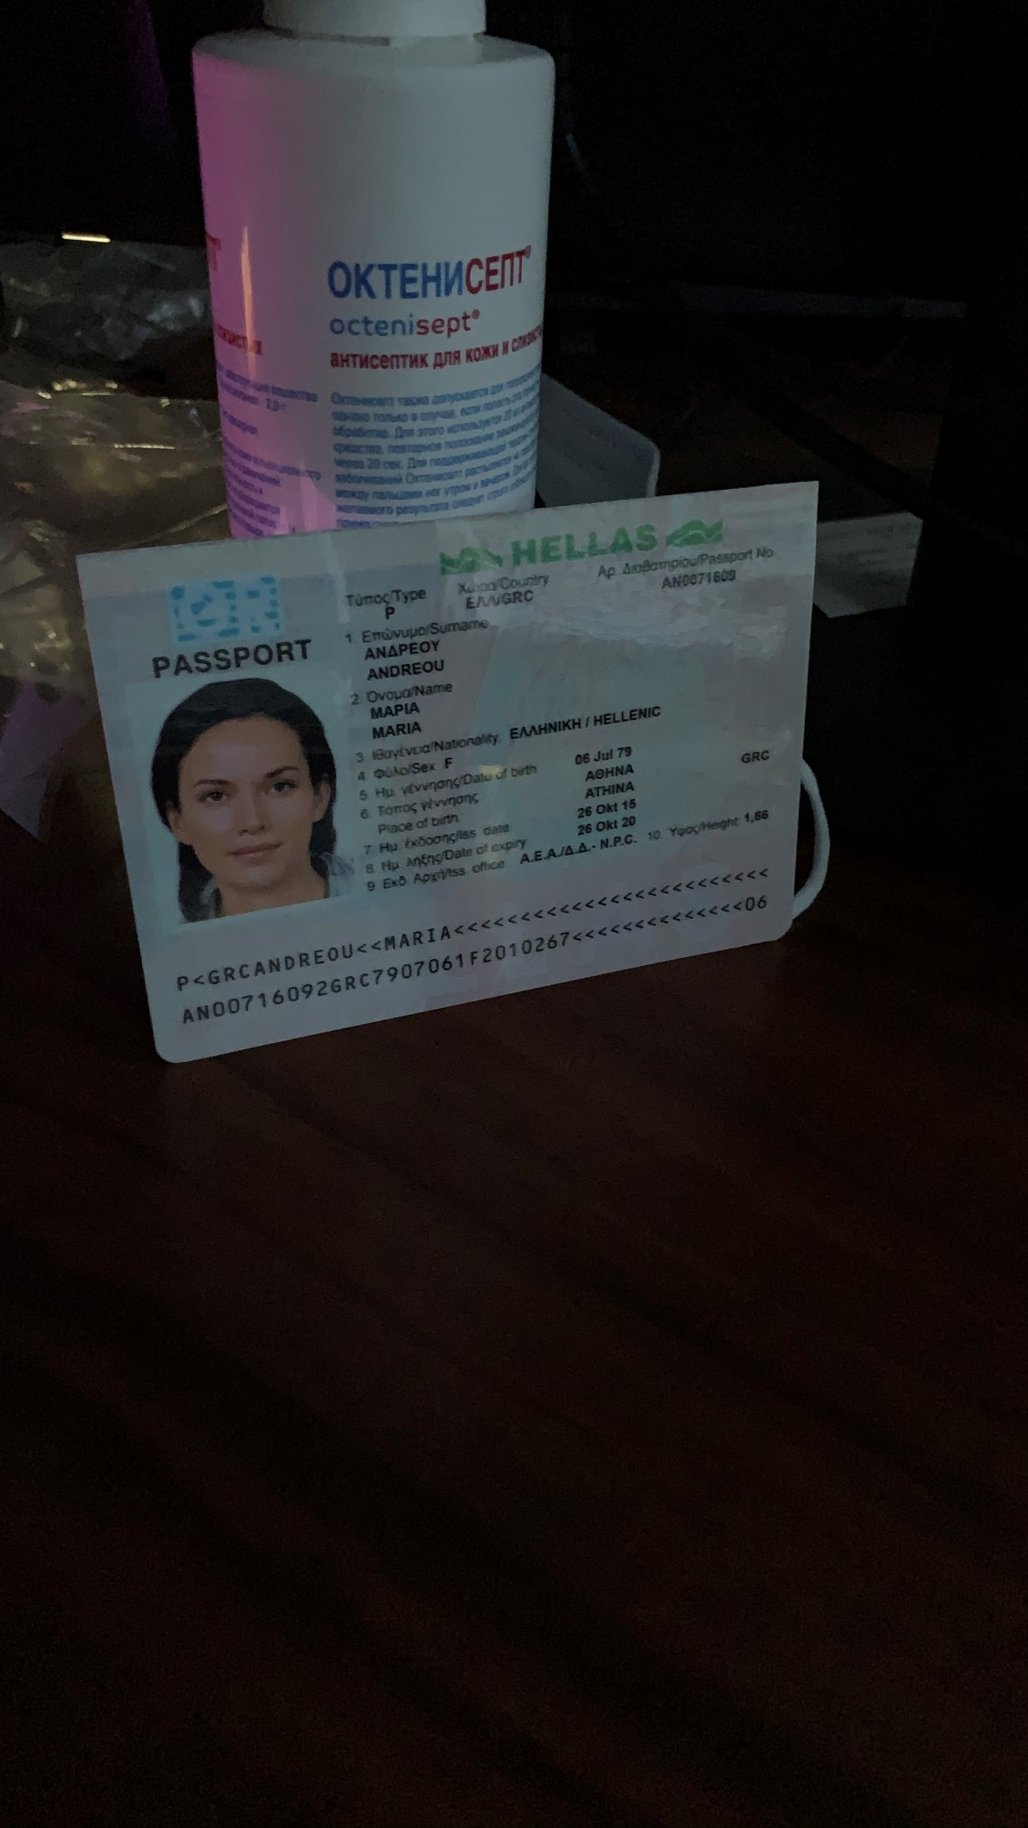
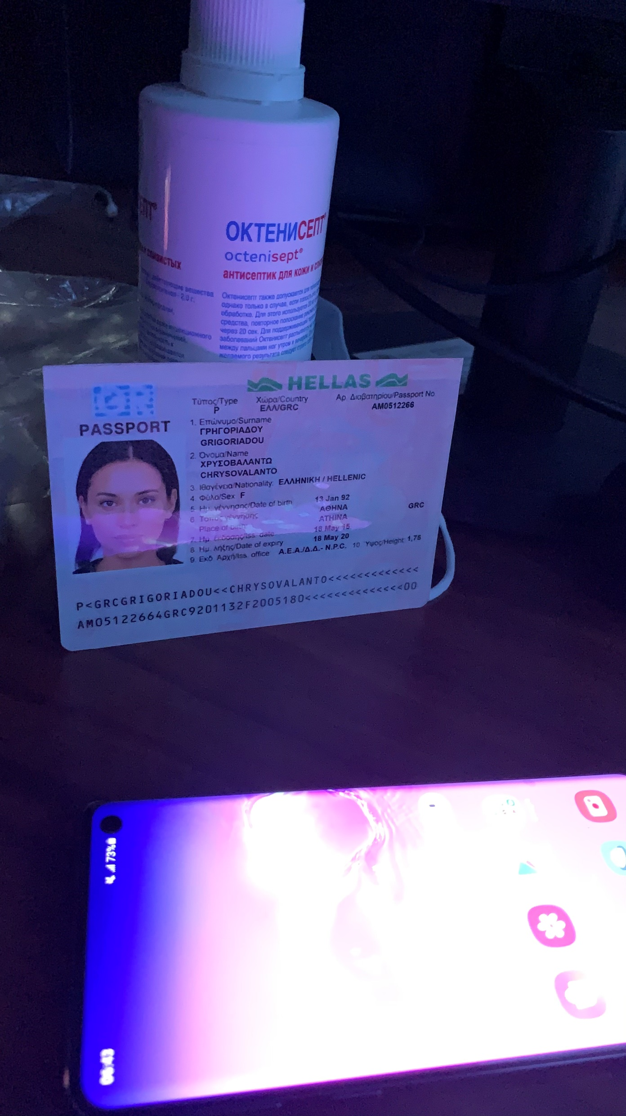
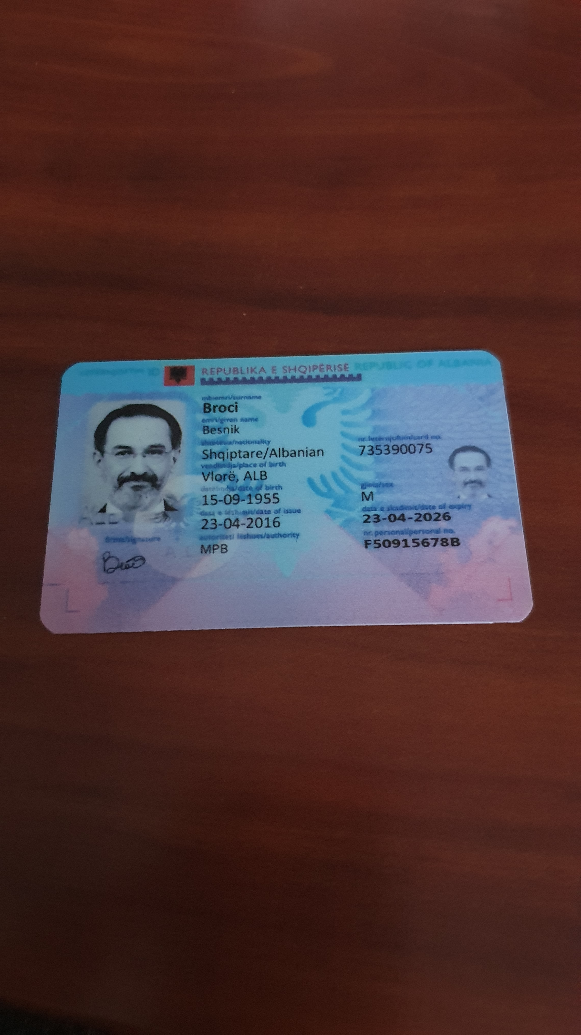
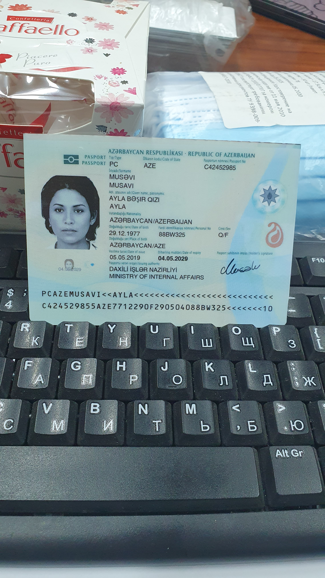
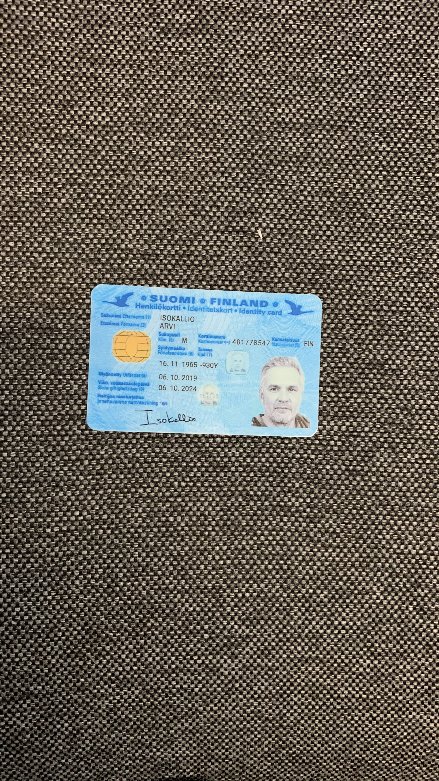
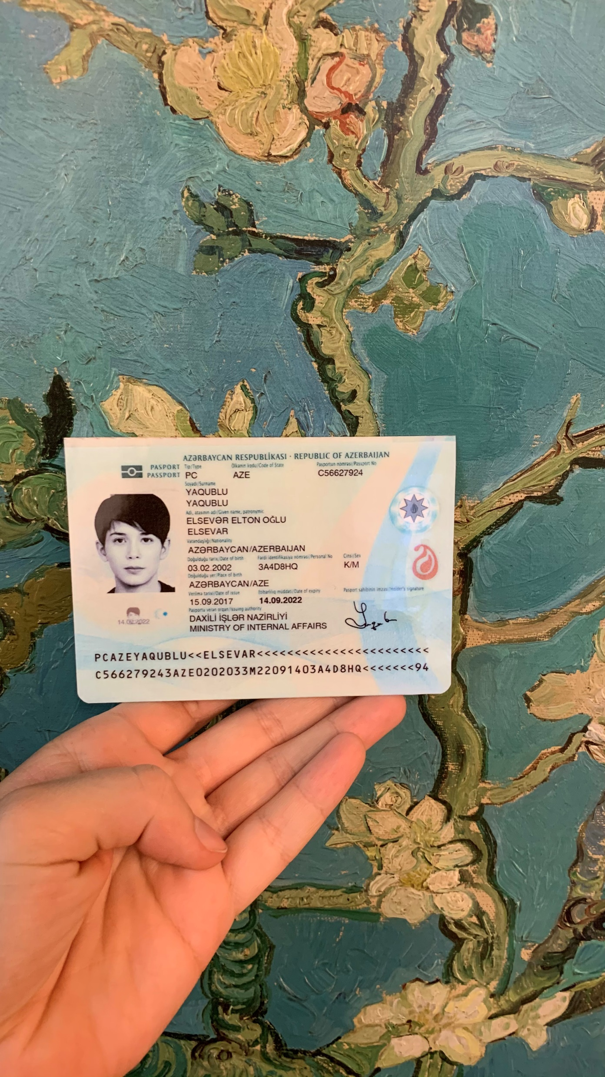
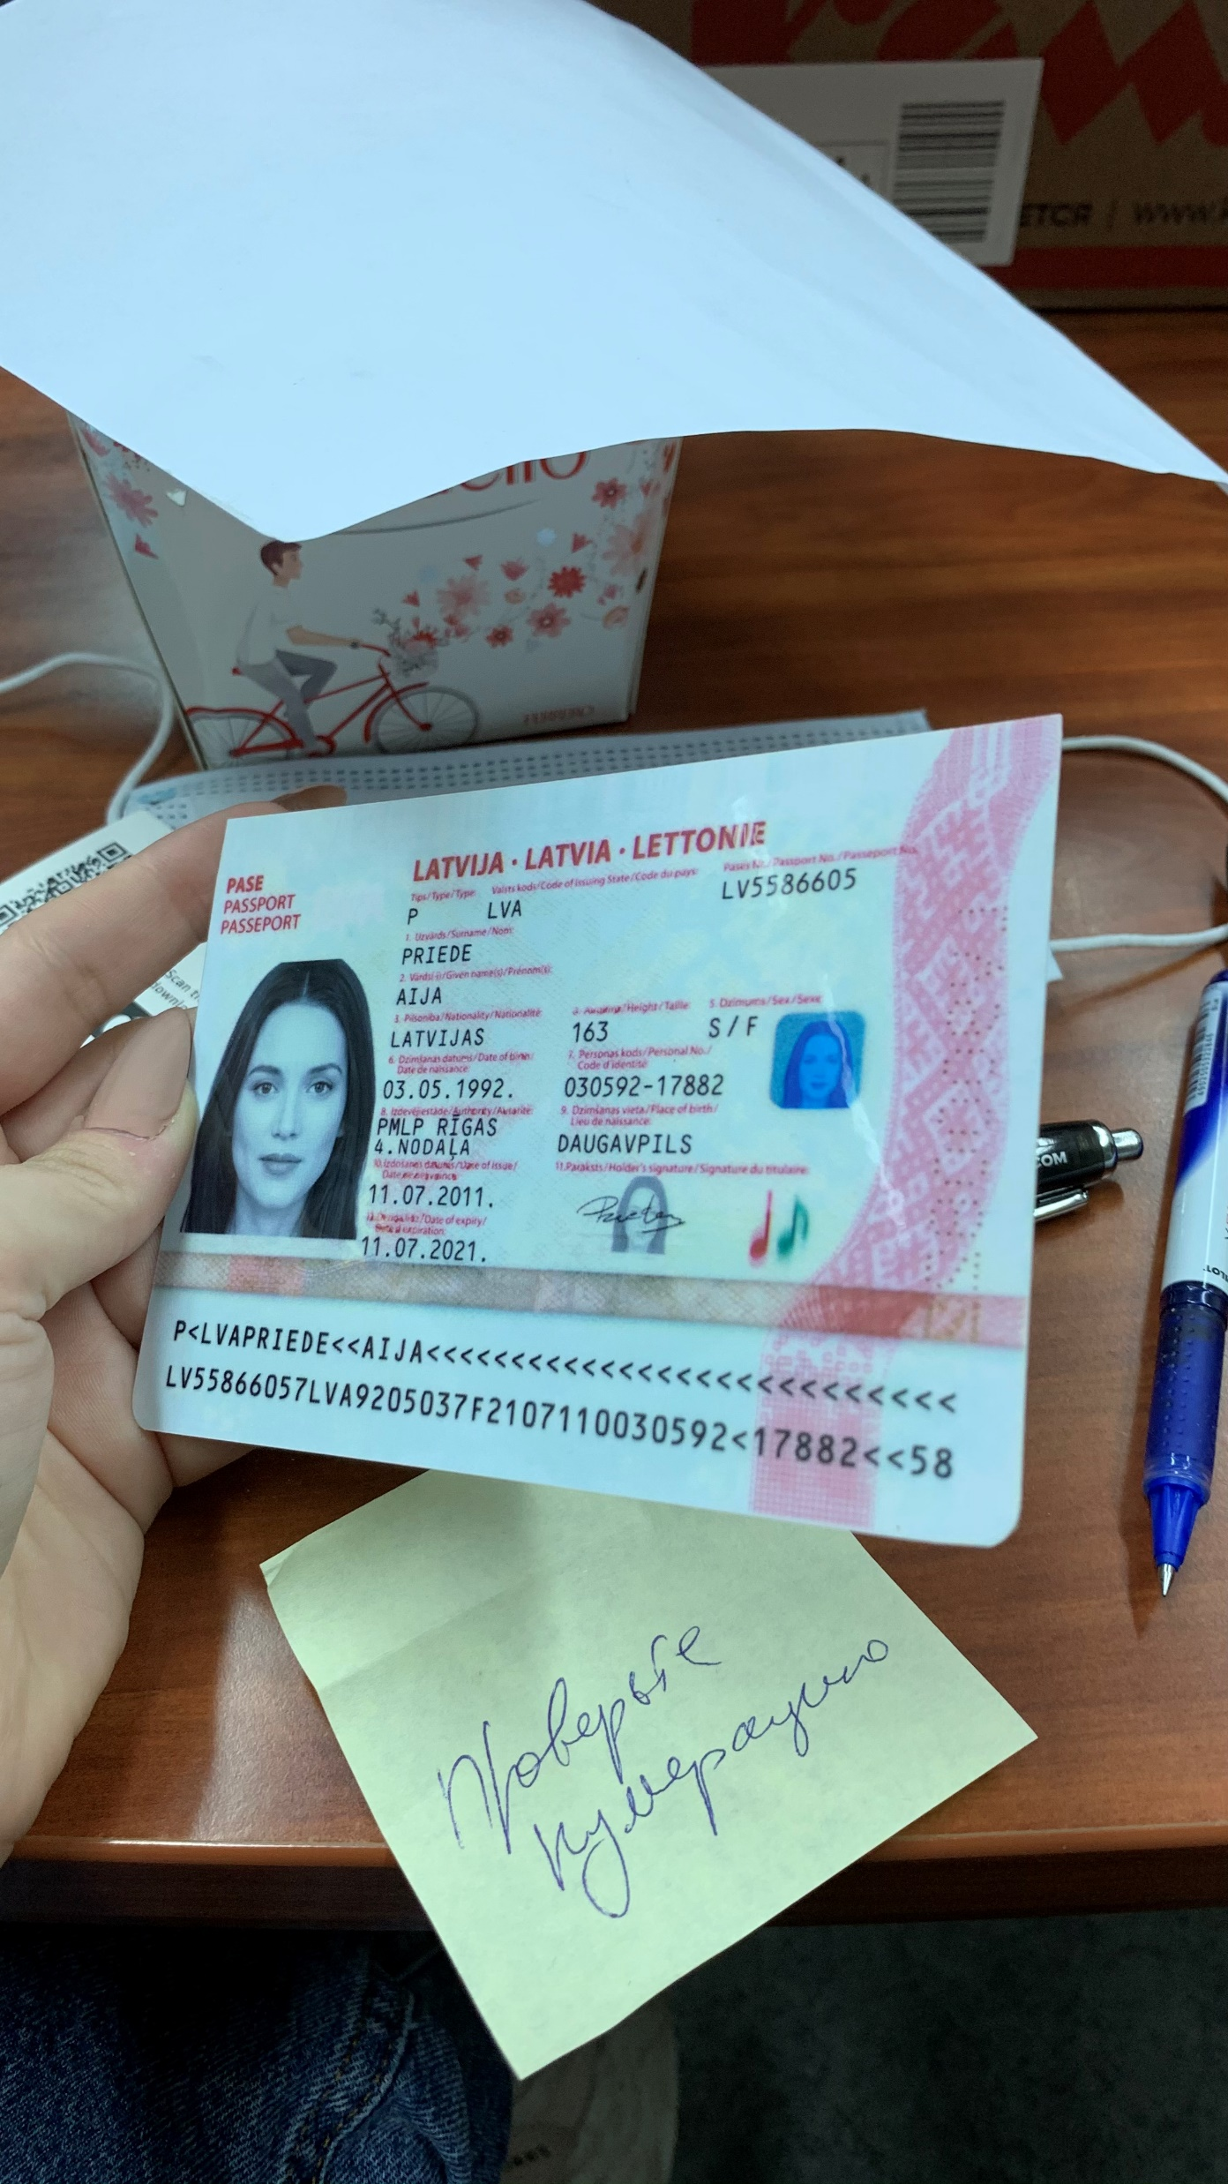
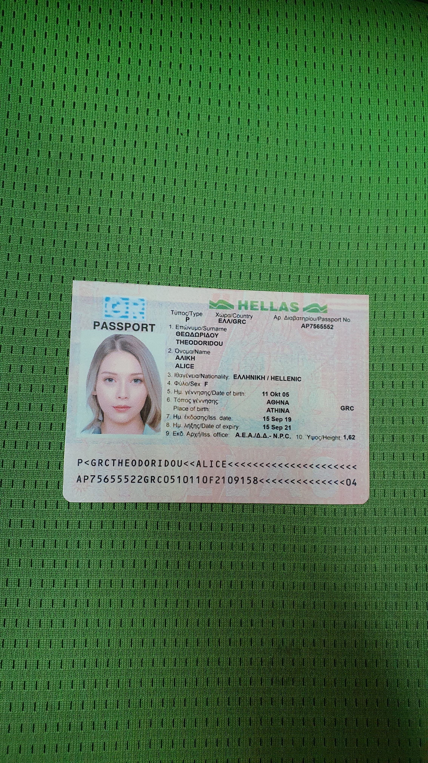
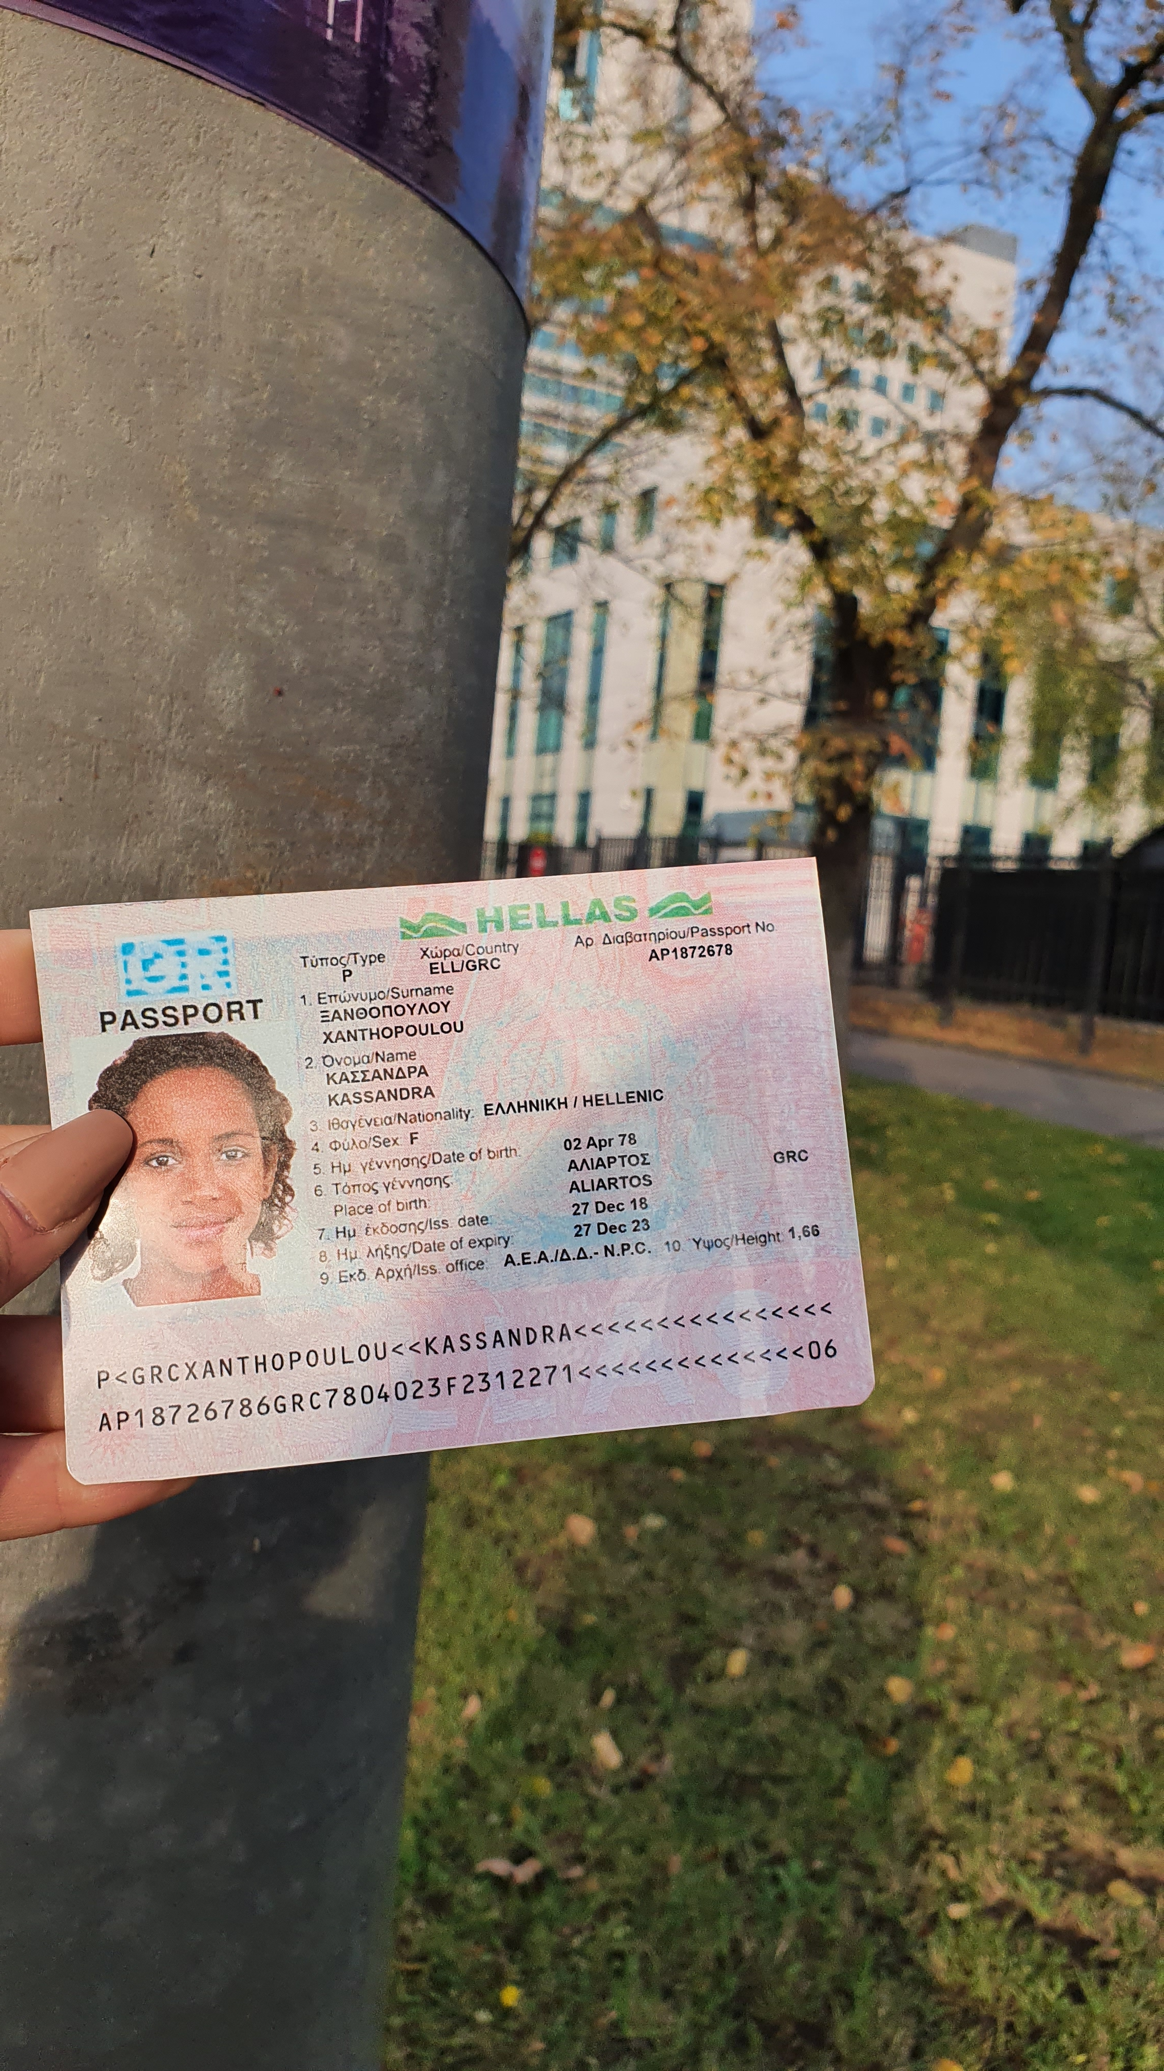
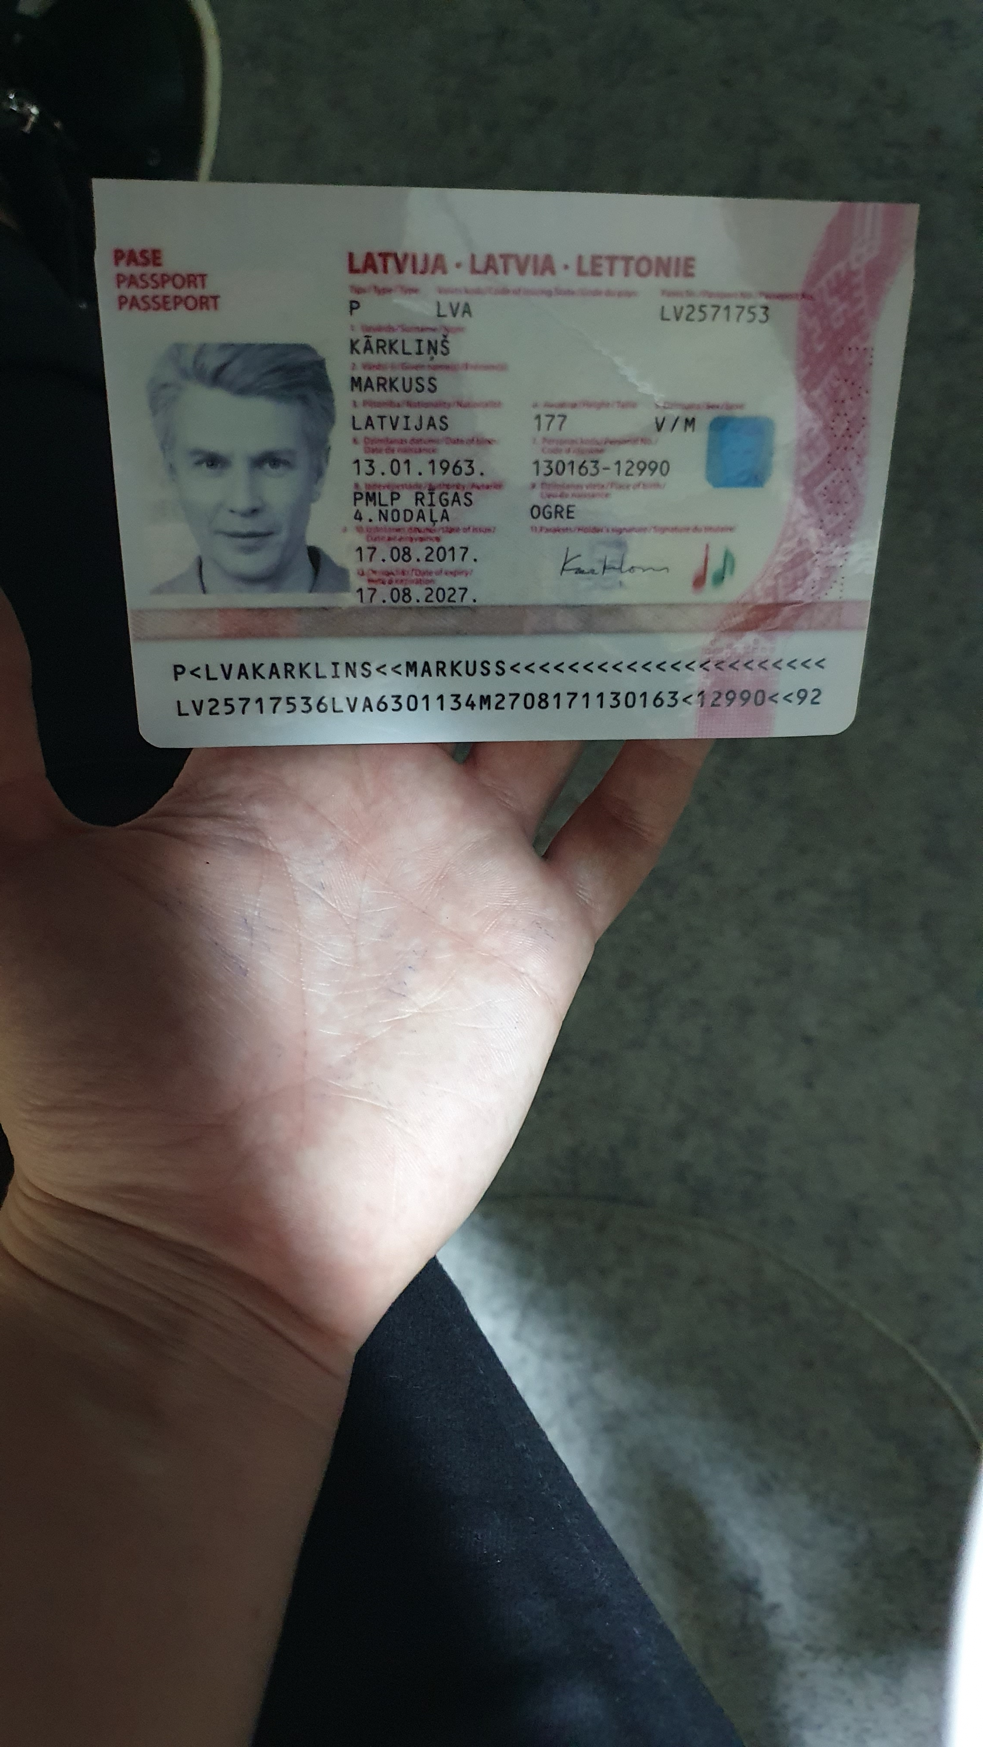
Dataset – Illustration (1)
Normal
Different background
Different brightness

Slide 12
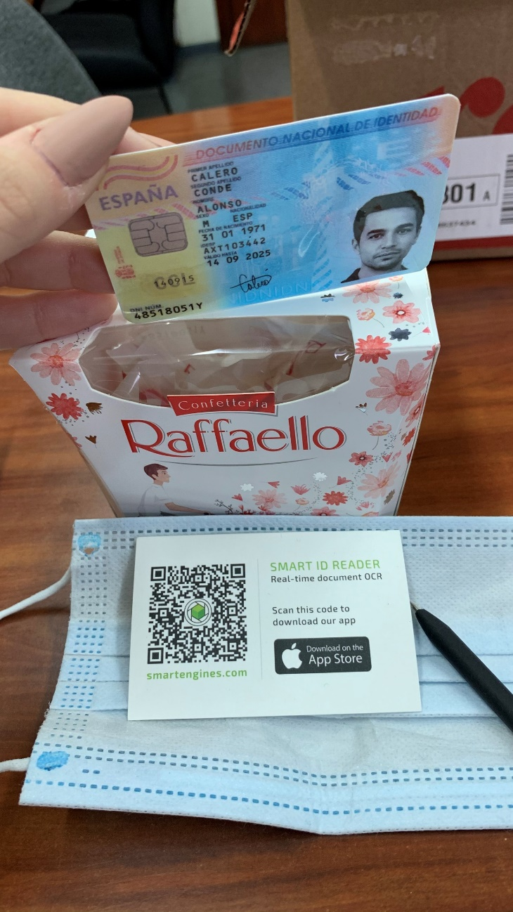
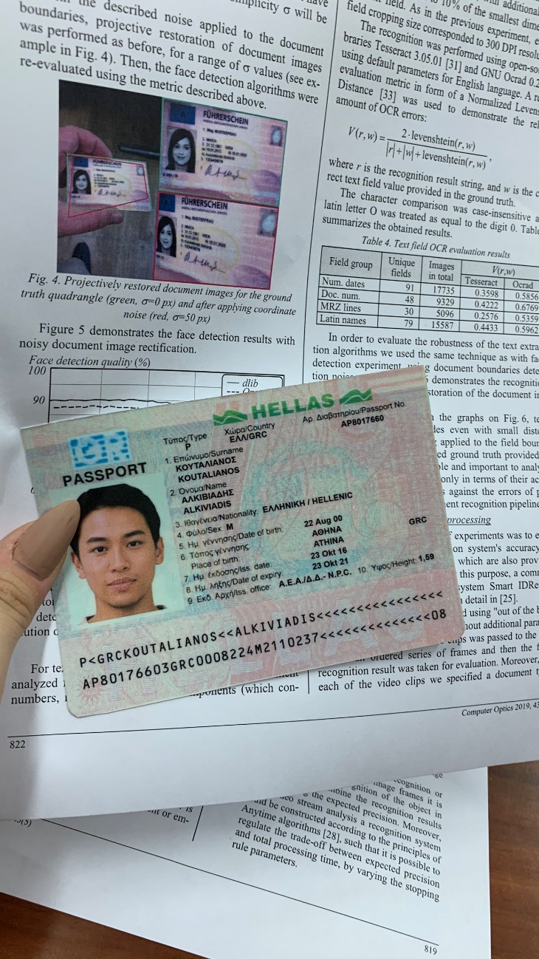
Dataset – Illustration (2)
Multiple cards
Fake ID in background

Slide 13
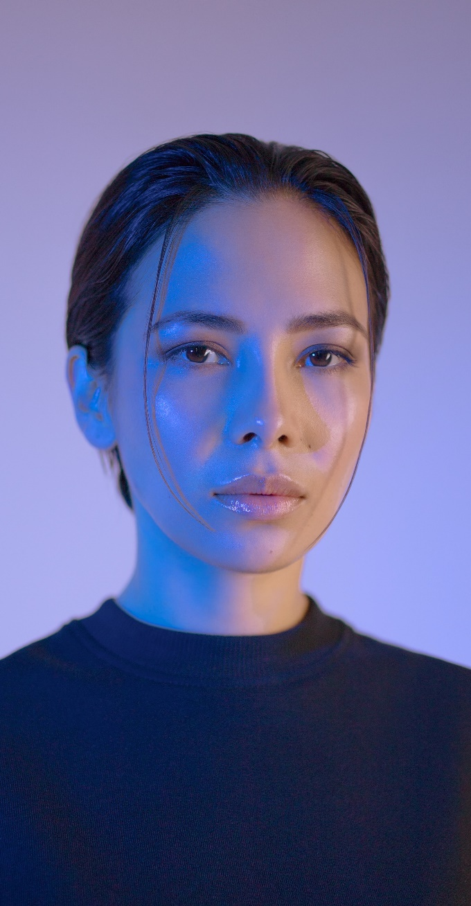
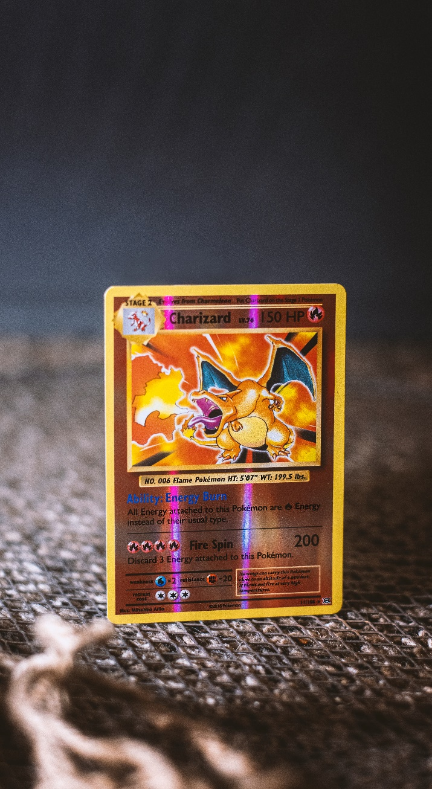
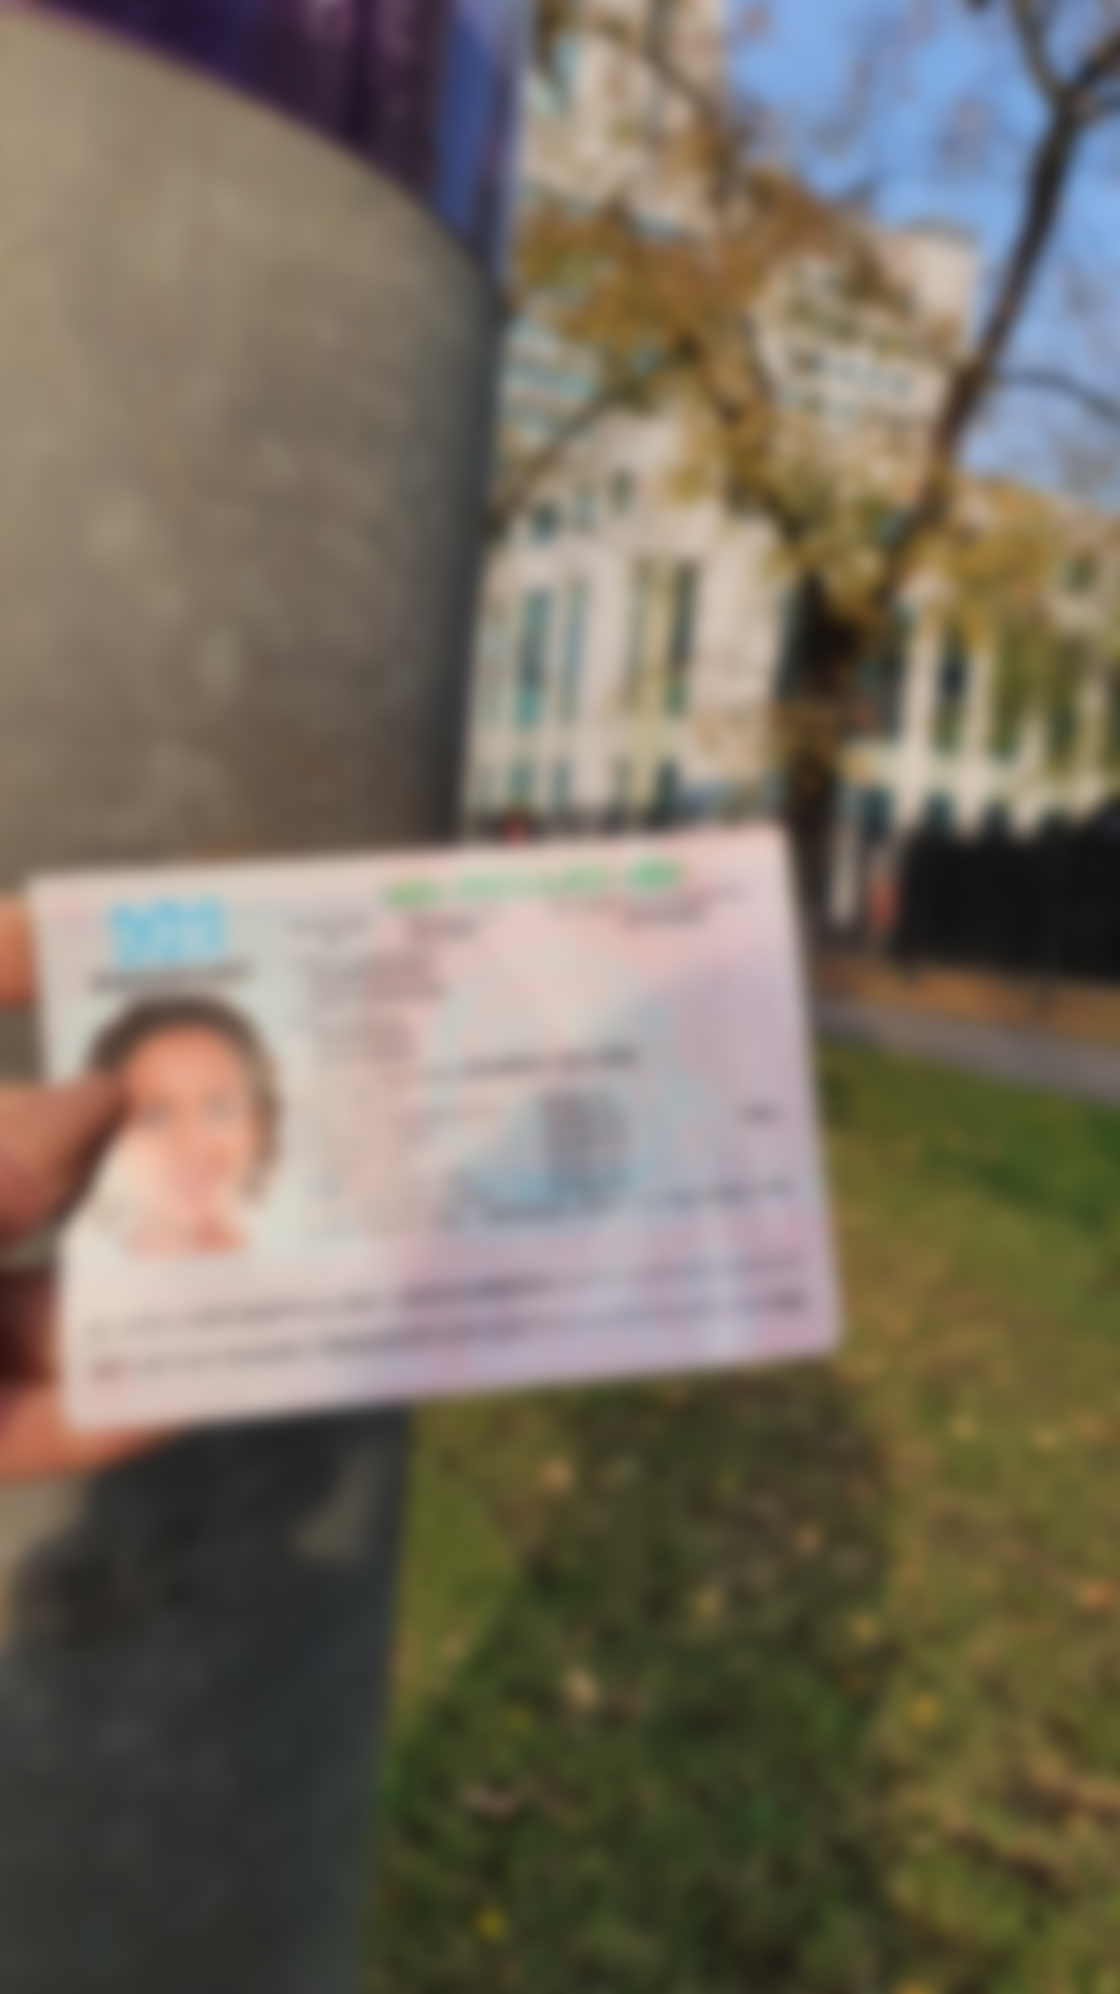
Dataset – Unacceptable Photos*
No Cards
Non-ID Cards
Too dark / bright
Blurred
*Need to generate: 1,000 for this ‘unacceptable’ class

Slide 14
Baseline Model
sd

Slide 15
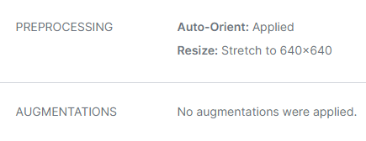
Improved Model 1
asd

Slide 16
Improved Model 2
sd

Slide 17
Summary
sd

Slide 18
Limitations & Areas for Improvement
asd

Slide 19
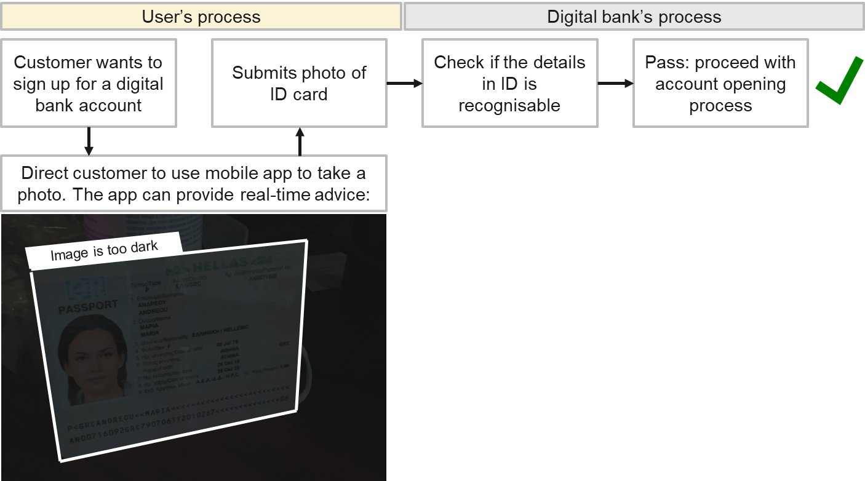
*Stretch Goal*
Using computer vision, automatically and quickly evaluate the submitted photo with the digital bank’s photo guidelines:
Challenge: multiclass object detection in videos

Slide 20
Thanks!
Do you have any questions?

Slide 21
Resources:
Theory | History of computer vision | Lil’log
 | Understanding MAP metric | Medium
 | Understanding labelling | SuperAnnotate
 | Understanding YOLOv3 | Paper
Computer vision workflow | Labelling with labelImg | Labelmg github Roboflow
 | Getting started with VS Code | VS Code
 | How to use YOLOv3 with Keras | Machine learning mastery
 | How to train YOLOv3 | Experiencor github Gilbert Tanner Kaggle
 | COCO dataset | COCO
Stretch goals | Multi-label CV using Keras | Analytics Vidhya
 | Streamlit deployment | thepbordin

Slide 22
Annex A: Dataset
The digitally generated photos were printed and made into physical documents
These documents were then taken under these conditions:
Low lighting conditions (20 documents of each type)
Keyboard as a background (10 documents of each type)
Natural lighting, captured outdoors (10 documents of each type)
Table as a background (10 documents of each type)
Cloth with various textures as a background (10 documents of each type)
Text document as a background (10 documents of each type)
High projective distortions of the document (20 documents of each type)
Highlight from the sun or lamp hides a portion of the document (10 documents of each type)
Each country abide to these pre-set parameters:
80% are adults (18 – 60 years old)
10% are seniors (>60)
10% are children, adolescents (<= 17)
50:50 male-female ratio
Source: MIDV-2020: A Comprehensive Benchmark Dataset for Identity Document Analysis

Slide 23
Annex: Brief History of YOLO
YOLO (You Only Look Once) is a popular object detection and image segmentation model developed by Joseph Redmon and Ali Farhadi at the University of Washington. The first version of YOLO was released in 2015 and quickly gained popularity due to its high speed and accuracy.
YOLOv2 was released in 2016 and improved upon the original model by incorporating batch normalization, anchor boxes, and dimension clusters. YOLOv3 was released in 2018 and further improved the model's performance by using a more efficient backbone network, adding a feature pyramid, and making use of focal loss.
In 2020, YOLOv4 was released which introduced a number of innovations such as the use of Mosaic data augmentation, a new anchor-free detection head, and a new loss function.
In 2021, Ultralytics released YOLOv5, which further improved the model's performance and added new features such as support for panoptic segmentation and object tracking. In addition, Ultralytics maintains a public open-source repository to provide guides and tutorials on the installation and use of YOLOv5 – making YOLOv5 easy to build and use.
Source: Ultralytics

Slide 24
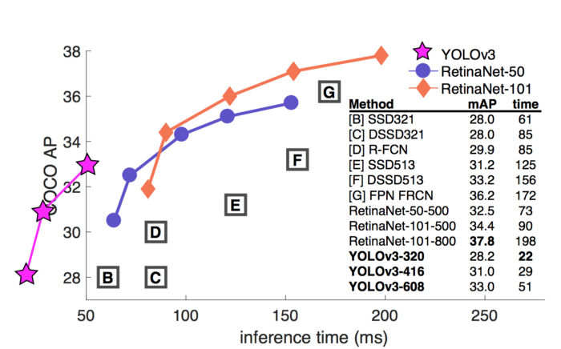
Annex: Why YOLO and Not Other Models?
YOLO is a single-shot detector* that uses a fully convolutional neural network (CNN) to process an image. It processes an entire image in a single pass, making them computationally efficient.
YOLO excels in detection speed, enabling object detection in real-time videos
Source: YOLOv3 paper
*Single-shot object detection uses a single pass of the input image to make predictions about the presence and location of objects in the image. Whereas a two-shot object detection uses two passes of the input image to make predictions about the presence and location of objects: the first pass is used to generate a set of proposals or potential object locations, and the second pass is used to refine these proposals and make final predictions

Slide 25
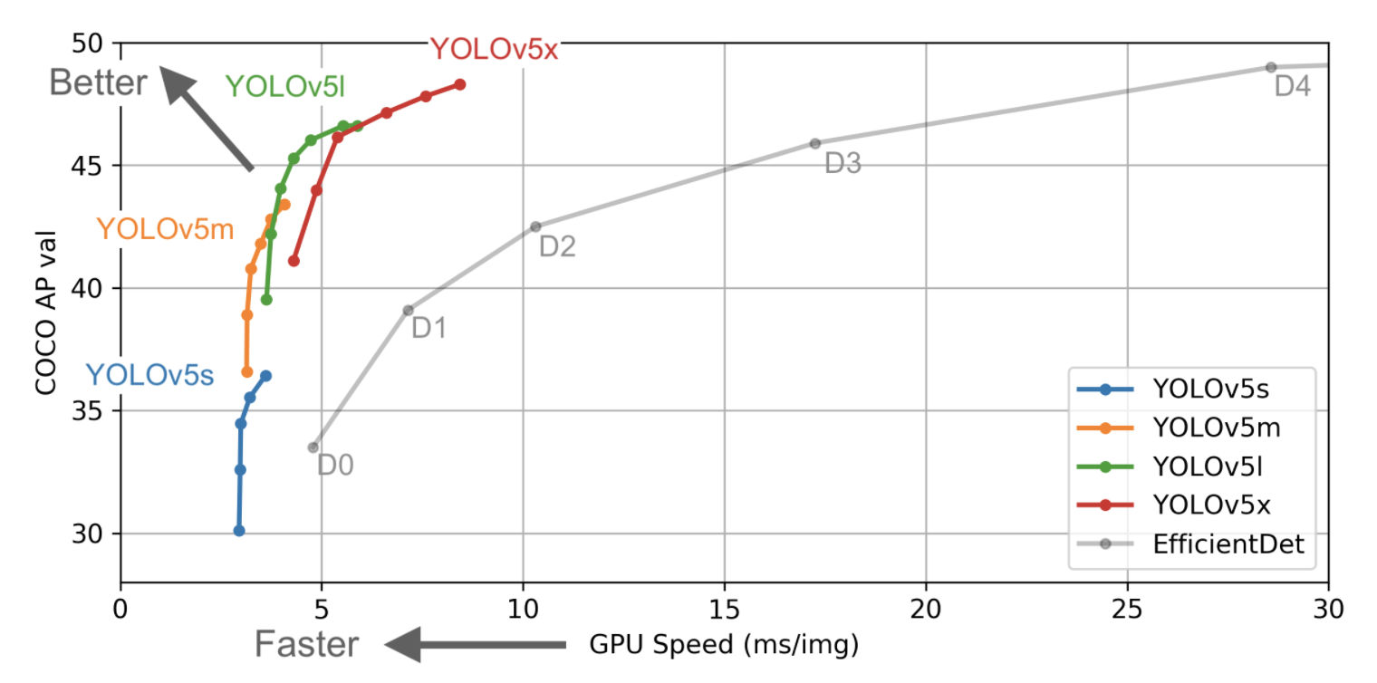
Annex: Why YOLOv5l (Large)?
YOLOv5l offers a balance between performance and speed of inference
Source: Ultraytics

Slide 26
Annex: YOLOv5 Architecture
The YOLO network consists of three main pieces.
Backbone: A convolutional neural network that aggregates and forms image features at different granularities.
Neck: A series of layers to mix and combine image features to pass them forward to prediction.
Head: Consumes features from the neck and takes box and class prediction steps.
https://towardsai.net/p/computer-vision/yolo-v5%E2%80%8A-%E2%80%8Aexplained-and-demystified
https://iq.opengenus.org/yolov5/
https://blog.roboflow.com/yolov5-improvements-and-evaluation/

Slide 27
Annex: Single-Shot Object Detection
asd

Slide 28
Annex: YOLOv5 Loss Functions
Classes loss(BCE loss)
Objectness loss(BCE loss)
Location loss(CIoU loss)

Slide 29
Annex: Mosaic Data Augmentation
asd

Slide 30
Annex: Auto Learning Bounding Box Anchors
asd

Slide 31
Annex: Non-Maximum Suppression
asd

Slide 32
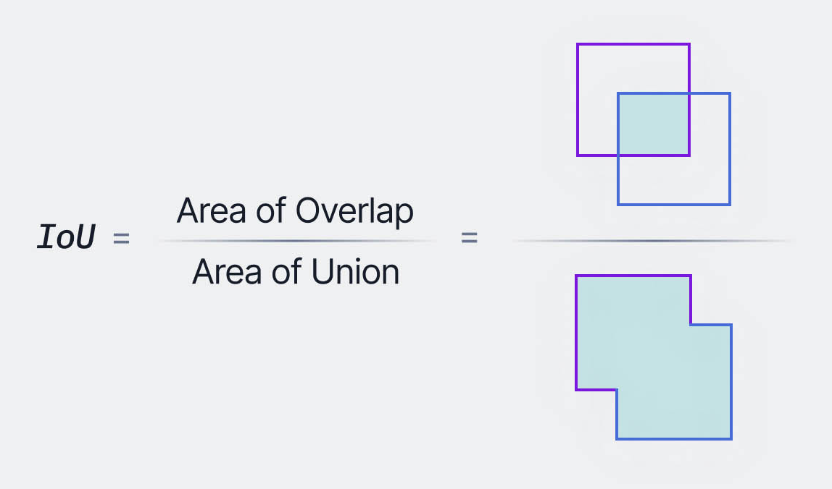
Annex: Intersection over Union (IoU)
Overview
IoU is a popular metric to measure localization accuracy and calculate localization errors in object detection models.
Detailed explanation
The formula for IoU is show on the right
E.g. IoU score of 0.54 = 54% overlap between the two boxes
A threshold can be set for the IoU score, to decide how much overlap constitutes a ‘positive’ classification
Ground truth bounding box
Predicted bounding box
Source: v7labs

Slide 33
Annex: Mean Average Precision (mAP)
Overview
mAP is a popular metric that measures the
Detailed explanation
Average Precision (AP) is calculated as the area under a precision vs. recall curve for a set of predictions.
Recall and precision offer a trade-off that is graphically represented into a curve by varying the classification threshold. The area under this precision vs. recall curve gives us the Average Precision per class for the model. The average of this value, taken over all classes, is called mean Average Precision (mAP).
https://blog.roboflow.com/mean-average-precision/
https://blog.paperspace.com/mean-average-precision/#:~:text=To%20evaluate%20object%20detection%20models,model%20is%20in%20its%20detections.
Source: v7labs

Slide 34











Project Workflow
Still optimistic!
1
2
3
Create capstone environment
Label images,
train-valid-test split
Instantiate & save YOLO model
4
5
Stretch goal!
Stretch goal!
6
7
Train model, predict
Analyse results
Detect ID cards in videos
Deploy on streamlit

Slide 35
Project Workflow
Still optimistic!
1
2
3
Create capstone environment
Label images
Instantiate & save YOLO model
4
5
Stretch goal!
Stretch goal!
6
7
Train model, predict
Analyse results
Detect ID cards in videos
Deploy on streamlit

Slide 36
User’s process
Digital bank’s process
Pass: proceed with account opening process
Customer wants to sign up for a digital bank account
Submits photo of ID card / passport
Check if the details in ID is recognisable
Fails: route for
re-submission
Processing time: 3 – 5 working days
Reference: an incorrect photo submission to Singapore’s ICA may double the process time¹ (2 weeks for NRIC, 4 weeks for passport²)

Slide 37
User’s process
Digital bank’s process
ID card: likely citizen, route to local ops/KYC process
Customer wants to sign up for a digital bank account
Submits photo of ID card / passport
Check whether it is ID card or passport
Passport: likely foreigner, route to another ops/ KYC process
Others: route for re-submission

Slide 38
User’s process
Digital bank’s process
Customer wants to sign up for a digital bank account
Submits photo of ID card / passport
Check if the details in ID is recognisable
Pass: proceed with account opening process
Direct customer to use mobile app to take a photo. The app can provide real-time advice:
Image is too dark

